Slide 1
Day 3
Classification Models

Slide 2
Before the Course
Upon completion of this course, you will have acquired general knowledge of introductory artificial intelligence algorithms and data analysis.
Since the specific topics are difficult to understand and it will not be easy for the person to settle the logic during the lesson, a lot of individual practice is required.
Slides will be explained with images rather than text. That is why it is extremely important to take notes during the lesson.
Since the titles are sufficient for basic level algorithms, the titles should be researched, and research should be done on sites that contain plenty of practice and theoretical information.

Slide 3

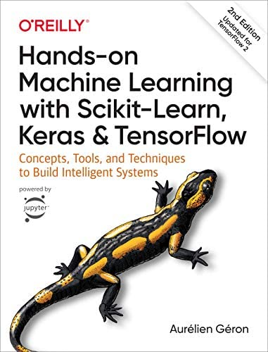
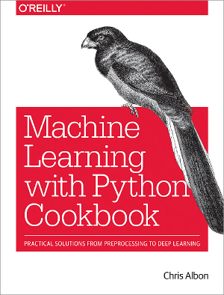
Sources
Deep Learning Türkiye
Hands-on Machine Learning with Scikit-Learn, Keras & TensorFlow
Aurelien Geron
Machine Learning with Python Cookbook
Chris Albon

Slide 4
Fethi Tekyaygil
Twitter: fethidev
LinkedIn: fethi-tekyaygil
GitHub: TekyaygilFethi

Slide 5
What Will You Learn In This Course
What is Classification?
How to classify with Logistic Regression?
What is the Activation Function?
Why do we use the Activation Function?
How do we measure the performance of our Classification Model?
Cross Validation
Accuracy, Confusion Matrix
What is the use and importance of Classification Threshold?
What is the place of ROC and AUC in performance measurement?
What is KNN(K-Nearest Neighbors) and SVM(Support Vector Machine)?

Slide 6

What Will We Learn Today?

Slide 7

What is Classification?
It is a supervised learning algorithm where input data can be easily categorized, tagging data and classifying them. There can be binary classifiers with only two outcomes, or multiclass classifiers with more than two.
It can be performed on both structured and unstructured data, as it is the process of classifying a particular dataset. The process begins with estimating the class of given data points. Classes are often called targets, tags, or categories.

Slide 8
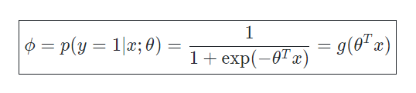
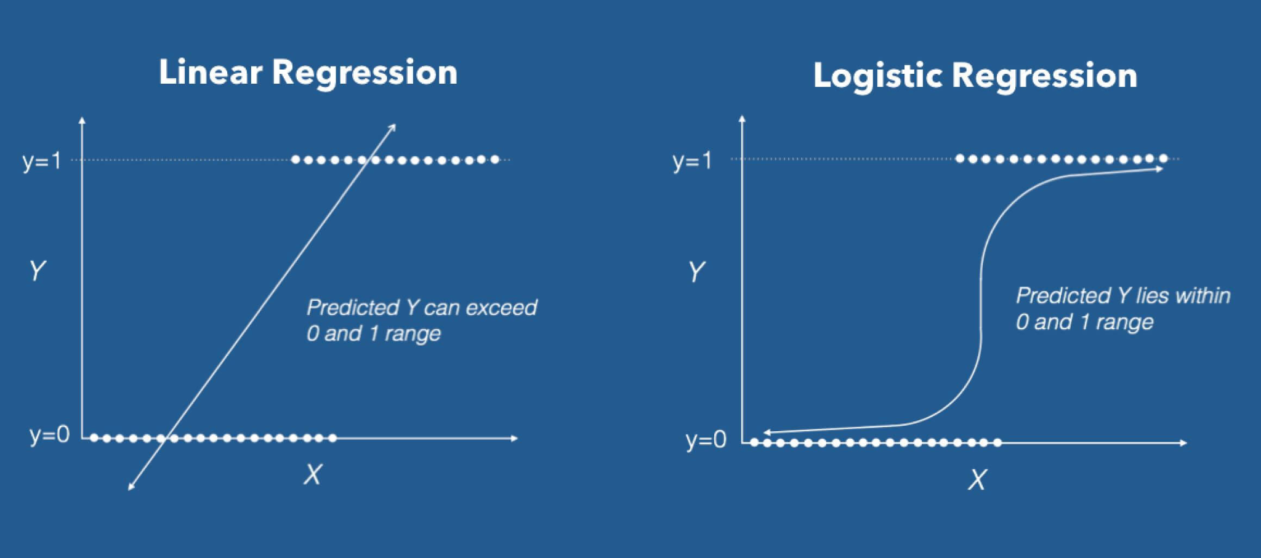
Lojistik Regresyon
Logistic regression is a regression method that performs classification in which the dependent variable is a categorical variable. The aim is to establish a linear model between dependent and independent variables.
It works if the dependent variable can take 2 different values
Logistic regression produces a specific probability value between 0 and 1, rather than predicting exactly 0 or 1.
Yes/No
Spam/Not Spam

Slide 9
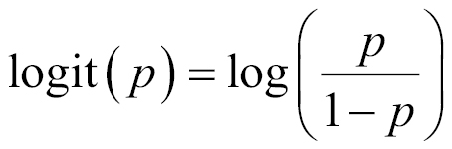
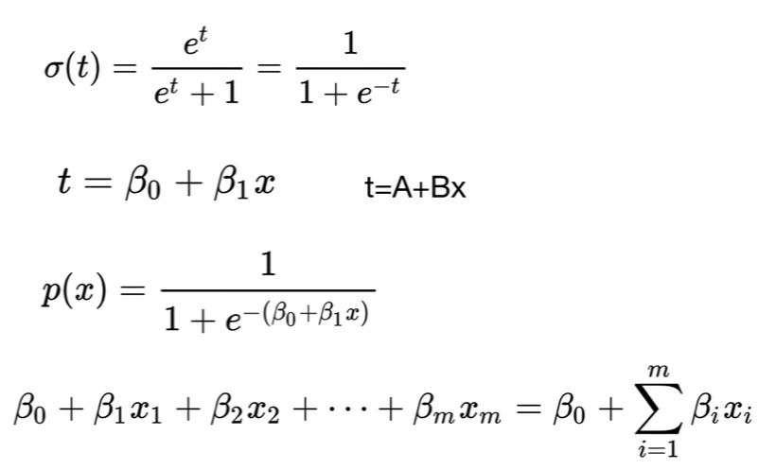
Lojistik Regresyon
As in Linear Regression, the weighted sum of the features is taken, but instead of giving the result directly, the Sigmoid activation function is applied to the result
Used for binary classification
Our output will be a probability value between 0 and 1
It is a function with "S" characteristic

Slide 10
Activation Function

Slide 11
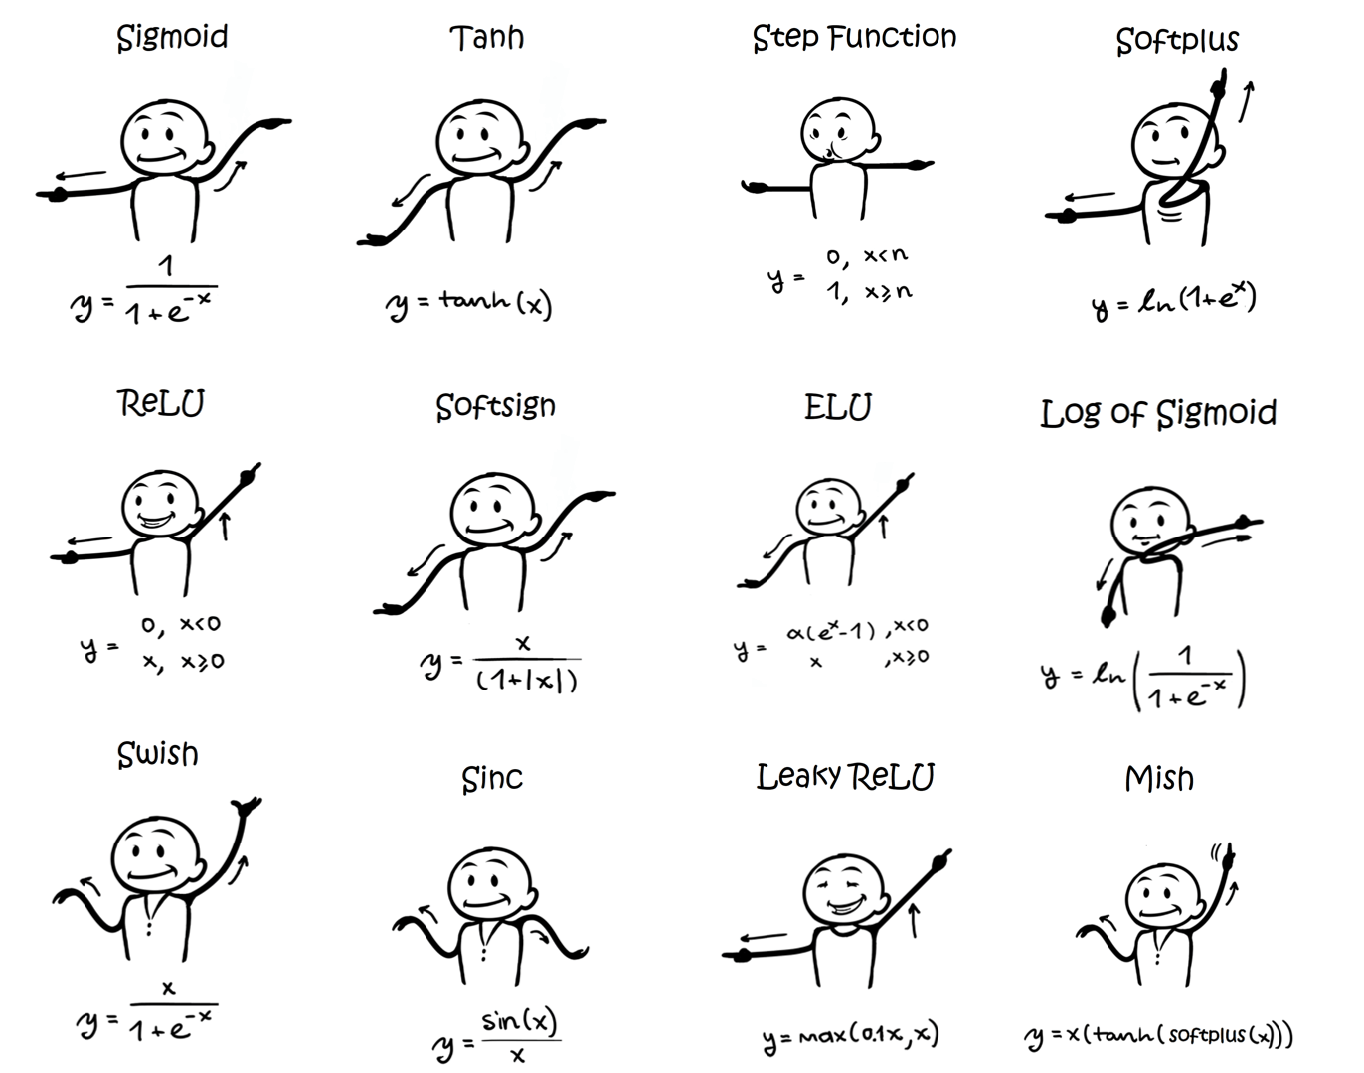
What is Activation Function
Activation functions are functions that determine how the output will be by processing the output of the model.
The linear regression formula cannot be used if it is desired to limit the output to a certain set of values, such as in classification problems.
While the dependent variable is the weighted sum of the independent variables in the linear regression formula, a special activation function should be applied to the output since the dependent variable must be squeezed between 1 and 0 in the binary classification problem.

Slide 12
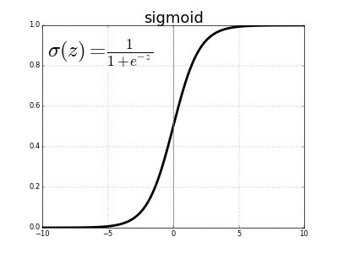
Sigmoid Fonksiyonu
The sigmoid function is an activation function that gives a probability value by compressing the output of the linear regression formula between 0 and 1. This means that the output value is between 0 and 1.
When the sigmoid activation function is used, small changes in the independent variables will cause a significant change proportionally on the dependent variable. No matter how much the independent variables change, the dependent variable will always be between 0 and 1

Slide 13
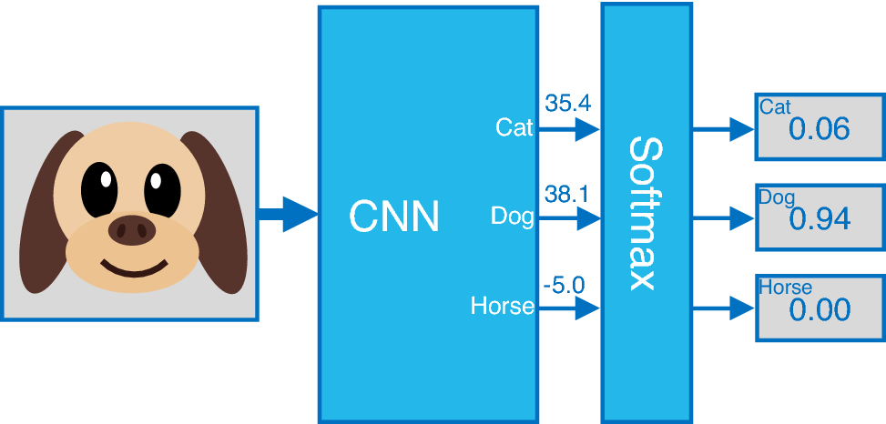
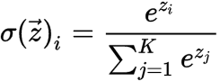
What to Do When We Have More Than Two Classes
Softmax Activation Function
Softmax, unlike the sigmoid function, is the activation function that allows our model to produce probability outputs for more than two classes.
In Deep Learning models, when Softmax activation function is used in the last layer, a separate probability value is returned for each class. The sum of these probability values is equal to 1.
E.g; In the model on the right, a probability value is generated for the Cat, Dog and Horse classes. When you look at these values, the model estimated that our input is 94% Dog, 6% Cat and 0% Horse.

Slide 14
Measuring the Performance of the Classification Model

Slide 15
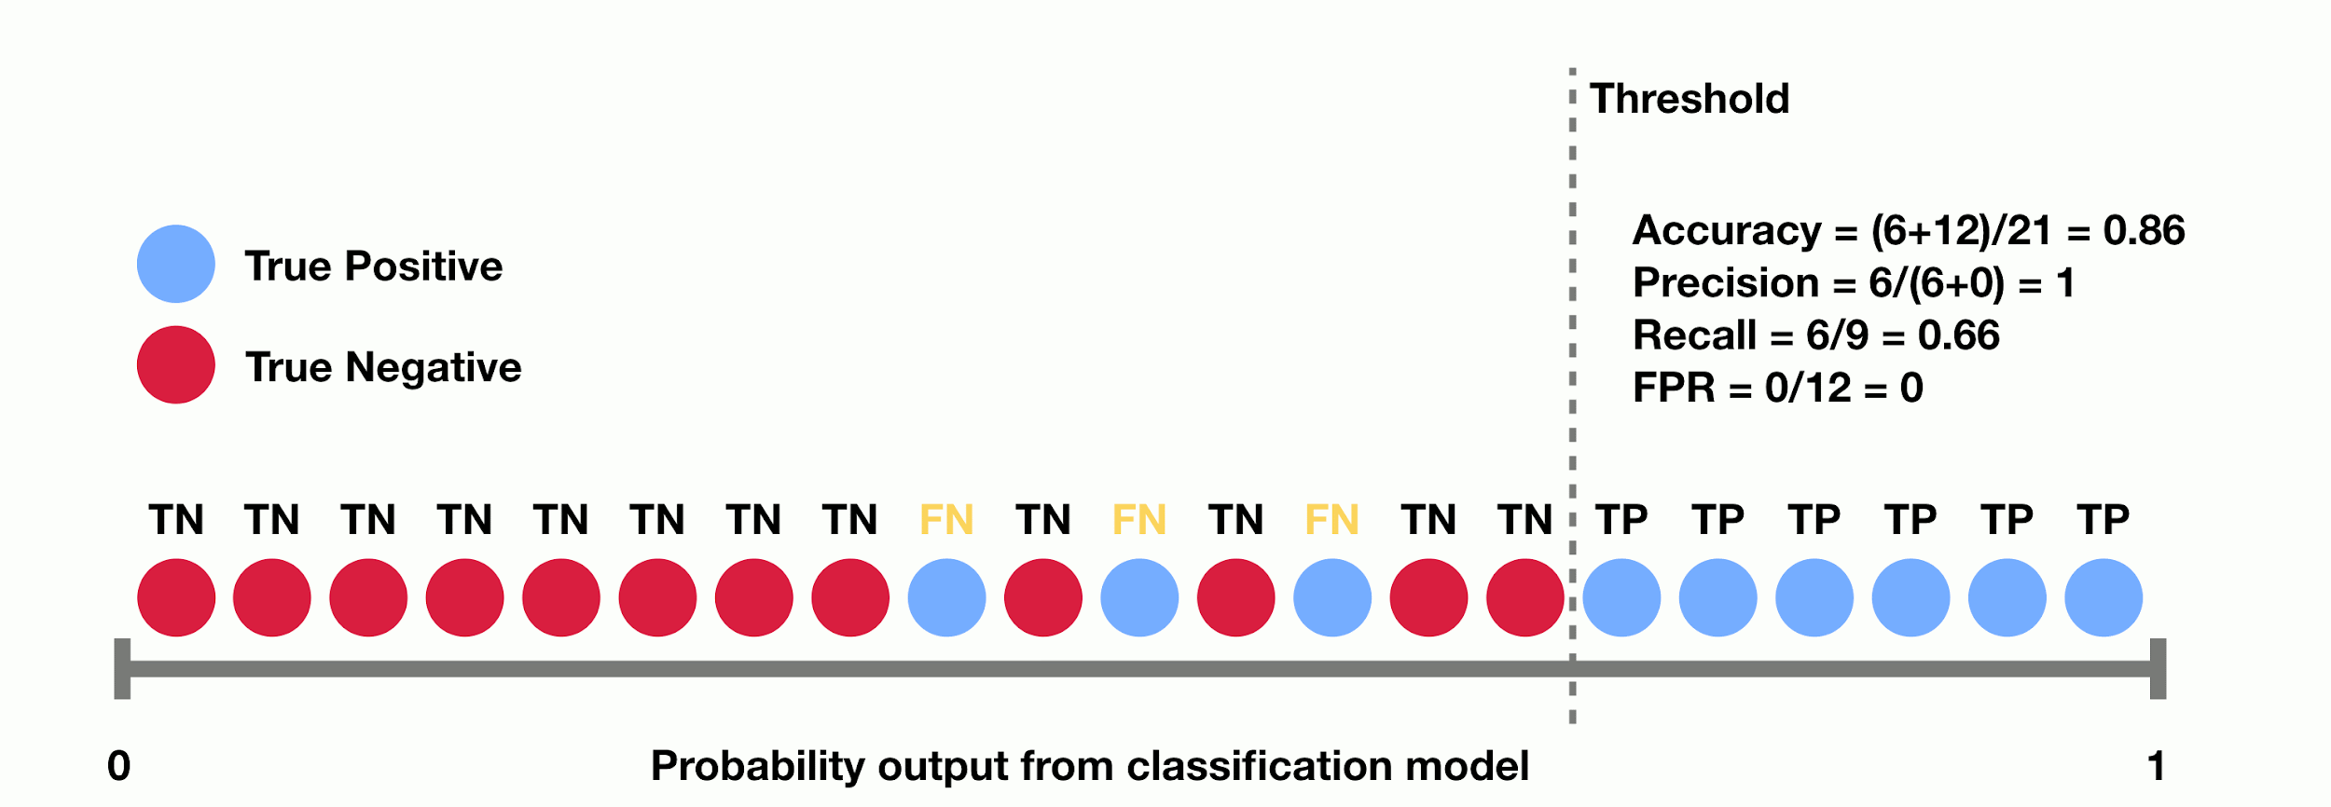
Classification Thresholding
The threshold is the value that determines which of the probability values estimated as a result of logistic regression will be accepted as true.
E.g; If a model that classifies mails according to whether they are spam is given a threshold of 0.5:
Emails with a spam probability greater than or equal to 0.5 are classified as spam.
Emails with a spam probability of less than 0.5 are classified as non-spam.

Slide 16
True vs False & Positive vs Negative
In order to measure the performance of the classification model, it is necessary to use some data. These data are True Positive, True Negative, True Positive and False Positive values.
Positive vs Negative
Our True and False values are basically our label classes.
E.g; in an email spam classification model can be assumed as:
“Spam” = Positive
“Not Spam” = Negative
True vs False
Our Positive and Negative values are related to the prediction results of our model.
E.g; When the model predicts a mail that is actually “Spam” (Positive) as “Not Spam” (Negative), this prediction becomes a False Negative prediction.
This is because our model performs a Negative prediction and this prediction is also False.

Slide 17
Confusion Matrix
It is a matrix in which the actual class value used to evaluate the performance of the classification model is compared with the predicted class value.
Positive: “Spam” Negative: “Not Spam”
True Positive: A result in which the model correctly predicts the positive class Truth: E-mail is Spam Prediction: E-mail is Spam | False Positive: It is a result in which the model cannot accurately predict the positive class Truth: E-mail is not Spam Prediction: E-mail is not Spam
False Negative: It is a result in which the model cannot accurately predict the negative class Truth: E-mail is not Spam Prediction: E-mail is Spam | True Negative: A result for which the model correctly predicts the negative class Truth: E-mail is not Spam Prediction: E-mail is not Spam

Slide 18
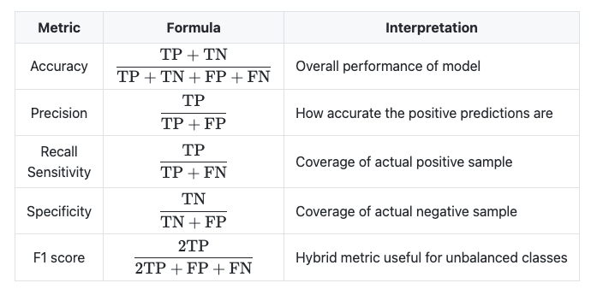
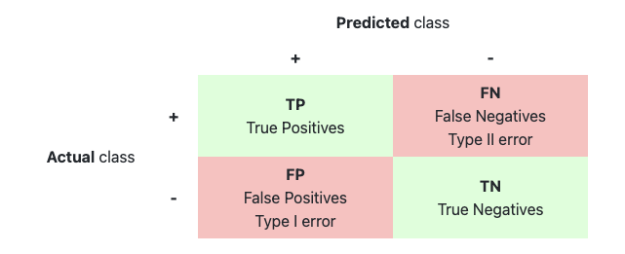
Accuracy
The Accuracy metric is the number of correctly guessed predictions divided by the number of all predictions.
Other classification metrics were needed because they were not sufficient on their own for imbalanced datasets.

Slide 19
Why Accuracy Alone Isn't Enough?
Total Mail Count: 100
Spam E-Mail Count: 98
Not Spam E-Mail Count: 2
Hypothesis: Modelin tüm mailler için Spam tahmini gerçekleştirmesi
True Positive 98 | False Positive 2
False Negative 0 | True Negative 0

Slide 20
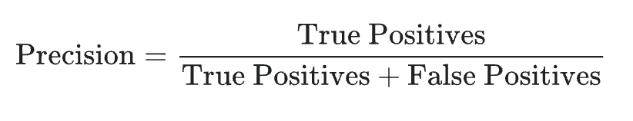
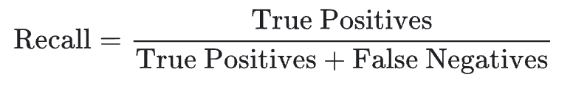
Precision & Recall
Precision and Recall are two metrics that measure the performance of the classification model.
Precision: It is a metric that seeks to answer of “How many of the positive predictions were correct?”
We can use the following Precision formula to answer this question:
Recall: It is a metric that seeks to answer of “How many of the actually positive results were predicted correctly?”
We can use the following Recall formula to answer this question:

Slide 21
Precision & Recall Calculation
True Positive 176 | False Positive 97
False Negative 64 | True Negative 70
Precision = 176 / (176 + 97) => 176 / 273 => 0.64
Recall = 176 / (176 + 64) => 176 + 240 => 0.73

Slide 22
When to Use Precision and Recall?
Precision: Precision is given priority when obtaining any False Positive value cannot be afforded. In other words, high precision is sought when no false detection can be afforded.
E.g; In a zombie apocalypse, you try to welcome as many healthy people (Negative) as possible into your safe zone, but you really don't want to accidentally pass a zombie (Positive) into the safe zone (False Positive). If your method causes some healthy people to accidentally avoid the safe zone, this is an acceptable method.
Recall: Recall is given priority when obtaining any False Negative value cannot be afforded. In other words, a high recall value is sought when no detection can be missed.
E.g; It's okay to classify a healthy person (Negative) as cancerous (Positive) (False Positive) and to have more medical tests, but it's definitely not correct to classify a cancer patient (Positive) as healthy (False Negative).

Slide 23
Confusion Matrix - Precision
Positive: “Not Zombie” Negative: “Zombie”
True Positive Truth: Not Zombie Prediction: Not Zombie | False Positive Truth: Zombie Prediction: Not Zombie
False Negative Truth: Not Zombi Prediction: Zombie | True Negative Truth: Zombie Prediction Zombie

Slide 24
Confusion Matrix - Recall
Positive: “Cancer” Negative: “Not Cancer”
True Positive Gerçek: Cancer Model Tahmini: Cancer | False Positive Gerçek: Not Cancer Model Tahmini: Cancer
False Negative Gerçek: Cancer Model Tahmini: Not Cancer | True Negative Gerçek: Not Cancer Model Tahmini: Not Cancer

Slide 25
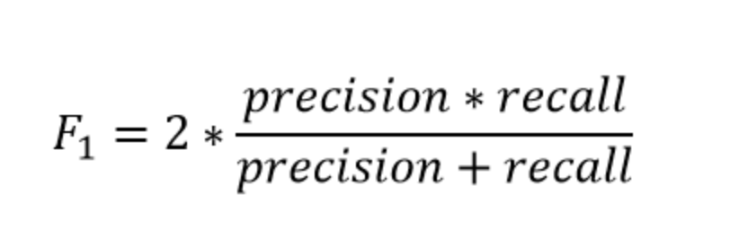
F1 Score
Although Precision and Recall may be preferred over each other in some cases, it may not be known which of the two will give better results in the model everytime. The F1 Score metric is equal to the harmonic mean of the Precision and Recall metrics, so it combines these two metrics.
The reason for the harmonic mean is that if the arithmetic average was taken, if one of the precision or recall values was 0, these values would not contribute to the average. In addition, precision and recall values in harmonic mean play an equal role in increasing the F1 Score.

Slide 26
Classification Threshold, ROC Curve & AUC
As the classification threshold changes, your Complexity Matrix values will also change depending on the threshold. Since the performance of the model will vary depending on the threshold, there are certain performance consequences for certain thresholds. To measure the performance of the model to its full extent, it is necessary to look at the ROC Curve and the AUC.
ROC Curve: A graph showing the performance of a classification model at all classification thresholds
AUC: It stands for "Area Under the ROC Curve". AUC measures the entire two-dimensional area under the entire ROC curve from (0.0) to (1.1)

Slide 27
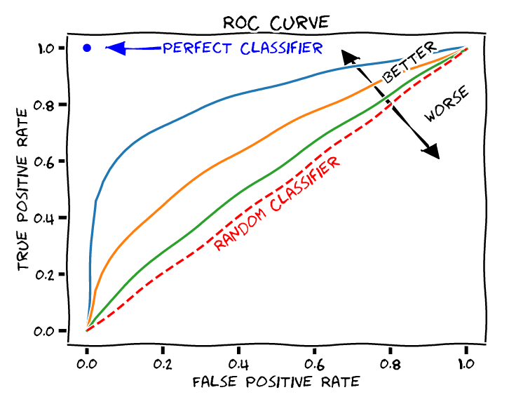
Classification Threshold, ROC Curve & AUC
The ROC Curve has two parameters:
True Positive Rate (TPR): Recall value
False Positive Rate (FPR): How many of the negative values are predicted incorrect?
A ROC curve plots TPR vs FPR at different classification thresholds. Lowering the classification threshold classifies more items as positive, increasing both False Positives and True Positives.
To calculate points on a ROC curve, a logistic regression model with different classification thresholds would have to be evaluated multiple times, but this method would be inefficient. We can do this more effectively by using AUC.

Slide 28
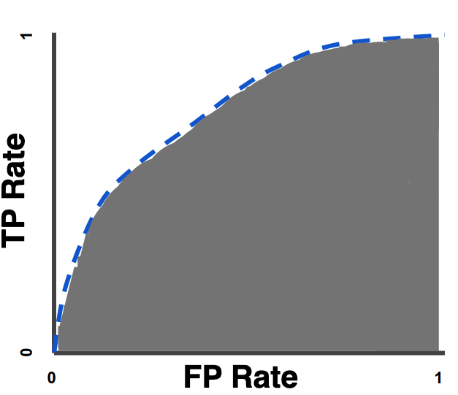
Classification Threshold, ROC Curve & AUC
AUC provides an aggregated measure of performance across all possible classification thresholds. In other words, our AUC determines how well our model classifies classes.
The AUC value is between 0 and 1.
At AUC = 0, the model performs every classification incorrectly
At AUC = 1, the model performs every classification correctly

Slide 29
Commonly Used Classification Algorithms

Slide 30
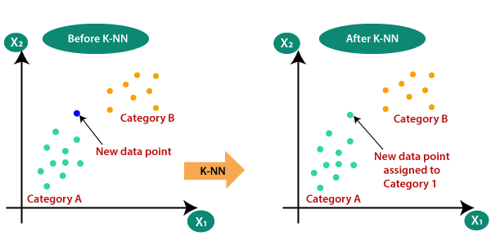
K-Nearest Neighbors
It is a Supervised Learning algorithm that assumes that similar features are close to each other in terms of distance.
Predicts that an observation belongs to the class with the largest ratio by looking at its nearest neighbors.
It is used to classify the data in a sample set by making use of its distribution. To estimate the class of a new data point, the distance of that point to the existing data points is calculated and its k number of close neighbors are checked.

Slide 31
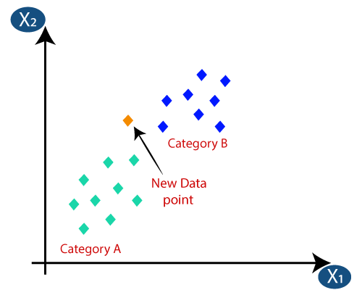
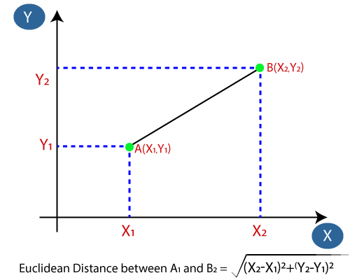
K-Nearest Neighbors
The data to be estimated is entered and the k parameter determines how many neighboring points to look at. Then, the Euclidean distance between the data is determined and the classes of the nearest points are checked. The new data point is estimated as this class.

Slide 32
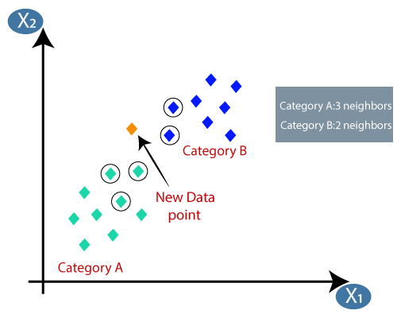
K-Nearest Neighbors
For example, in the visual, let the orange data point be the data point to be classified by the model. Assuming the k value is 5, the Euclidean distance to the 5 closest data points is looked up.
Since 3 data points from Category A and 2 data points from Category B are adjacent, the data point is classified as Category A.

Slide 33
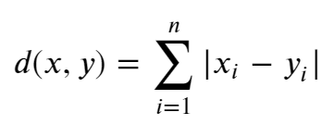
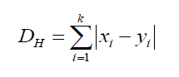
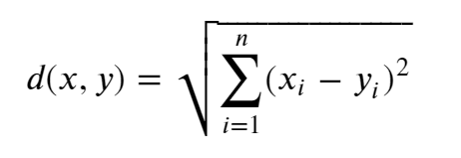
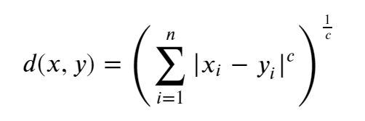
K-Nearest Neighbors
Mesafe Ölçümleri
Problemin içeriğine bağlı olarak, farklı uzaklık ölçütleri kullanılabilir.
Minkowski mesafesi, C değişkenine bağlı bir uzaklık hesaplamak isteniyorsa Minkowski yöntemi kullanılır.
C = 1 olduğunda formül Manhattan mesafesini verir
C = 2 olduğunda, Öklid mesafesini verir
Hamming mesafesi iki adet ikili dizi arasındaki benzerliği verir
Manhattan distance
Hamming distance
Euclidean distance
Minkowski distance

Slide 34
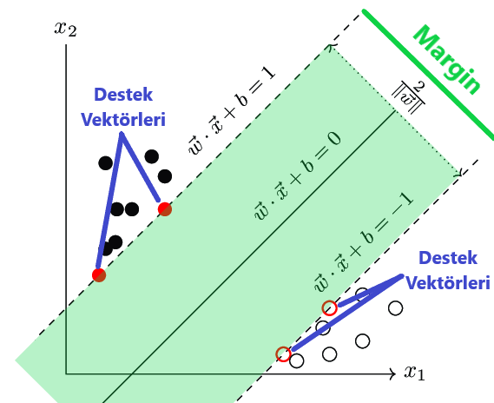
Support Vector Machine (SVM)
SVM is a powerful and versatile Machine Learning model capable of linear or nonlinear classification, regression and even outlier detection.
SVMs are particularly well suited for classifying complex small or medium datasets
Adding new data points to the plane does not affect the Decision Boundary line and support Vectors

Slide 35
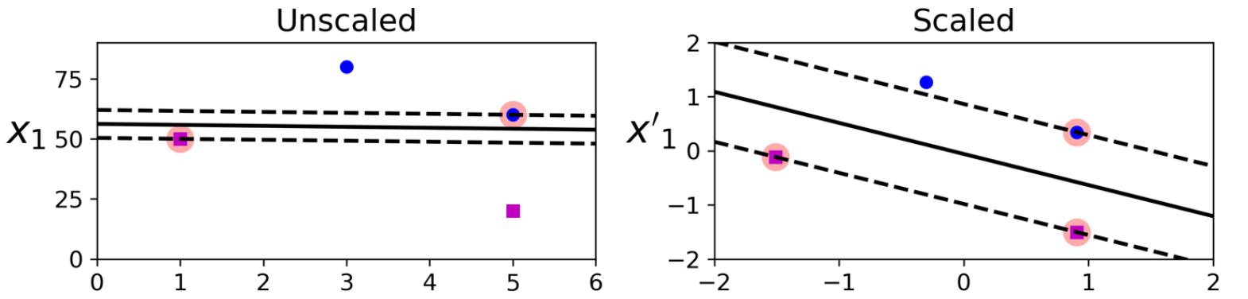
Support Vector Machine (SVM)
In the example below, the middle line is the Decision Boundary that separates the classes, while the dashed lines on the +-1 margins of this line are Support Vectors.
SVM can be thought of as the widest street between two classes of data.
SVMs are sensitive to feature scaling

Slide 36
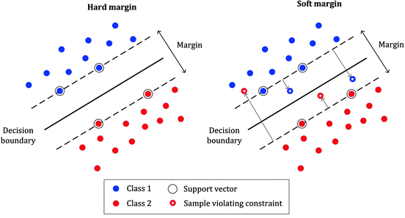
Hard Margin ve Soft Margin
The distance between the Decision Boundary line and the data point closest to it determines the Margin. Margin is the width at which the limit can be increased before reaching the data point. Some misclassification must be allowed so that the SVM model does not fit so well into outliers.
Hard Margin means that the data does not fall within the margin limits. In other words, it means that the model overfits the data and does not allow misclassification.
Soft Margin, Soft Margin is when some data falls within Support Vectors boundaries. In other words, some misclassifications are tolerated in classification.

Slide 37
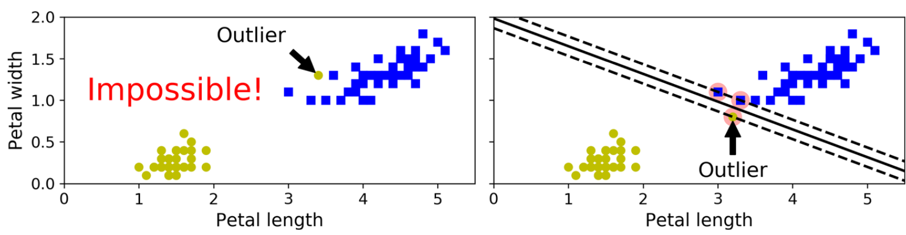
Hard Margin vs Soft Margin
Hard Margin: Hard Margin works if the data can be separated linearly.
If our model does not tolerate misclassifications, the difference between the boundary observations and the threshold is the Hard Margin.
Soft Margin: In order to avoid the outlier problem in Hard Margin, a more flexible model should be used. This flexibility is to allow some misclassification.
If our model tolerates these misclassifications, the difference between the boundary observations and the threshold is the soft margin.
Notes:
Amaç destek vektör genişliklerinin büyük tutmak ile sınır ihlallerini sınırlamak arasında iyi bir denge bulmaktır.

Slide 38
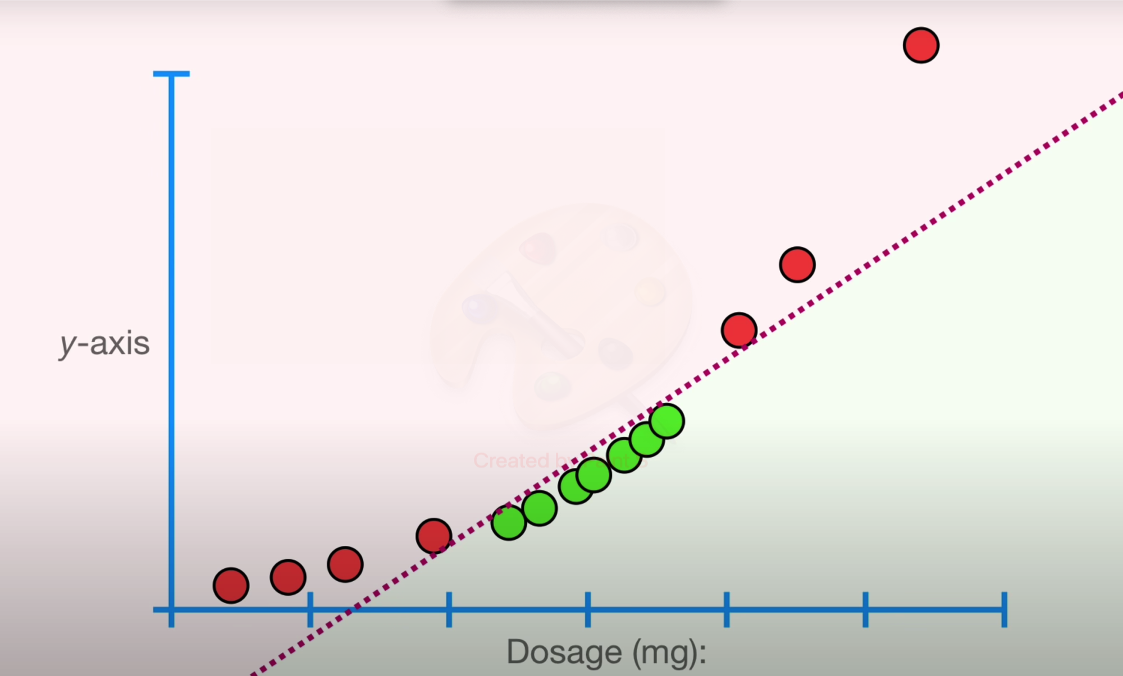
SVM Kernel Trick
SVM tries to classify data linearly, but SVM will not be able to perform performance prediction on data that is not linearly distributed. In such a case, Kernel Trick is used.
Polynomial Kernel
Linear classification is provided by creating a new dimension by increasing the dimension.
The size of the data to be best separated by the SVM can be decided by Cross Validation.

Slide 39
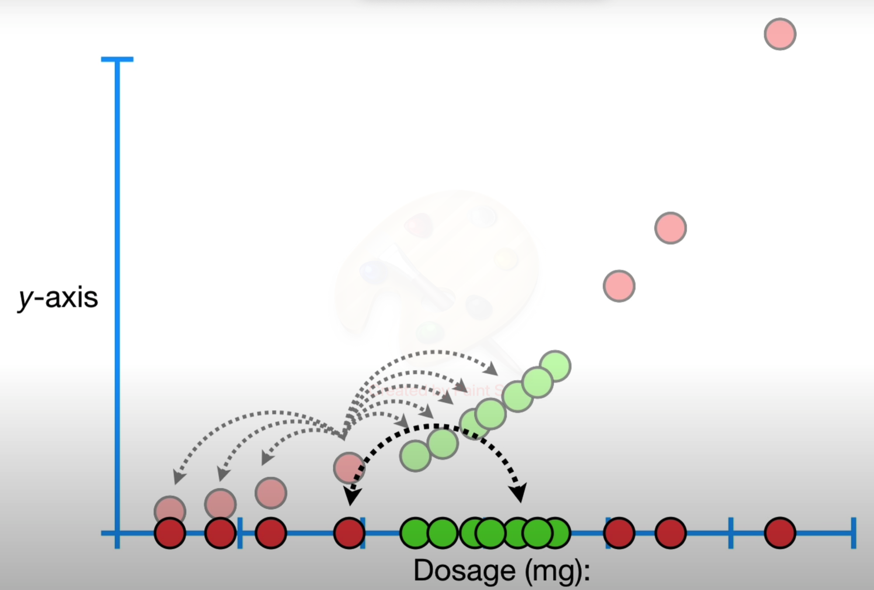
SVM Çekirdek Hilesi
As the data is converted to nonlinear form with a high-order polynomial equation, performance loss begins.
The kernel trick makes it possible to achieve the same result, even with polynomials of very high order, as if many polynomial features were added without having to add them. Therefore, there is no explosion in the number of features as no features are actually added.

Slide 40
Colab Time!

